Slide 1

INDEXING& FILING OF MEDICAL RECORDS

Slide 2
What is Indexing and its importance ?
Medical Records Indexing is the process of maintaining or arranging the patient’s medical reports in Chronological order or in alphabetical, numerical or by DOS, Specialty, Physician Name, etc., or by any particular methodology, the practice or the physician requires.
Indexing helps to locate the position of the specific document in files at a short period of time.
It helps to make a quick decision by providing necessary information stored in files.
Therefore, indexing is very important to save time and effort of employees.

Slide 3


Slide 4
Medical records indexing is used to store two different medical record documentation patterns, the source-oriented medical record and the problem-oriented medical record.
Medical records indexing helps medical staff to locate the position of the specific medical record in files at a short span of time.
Having unique records dramatically improves search time. Easier Categorization: Records indexing makes it easier to group documents by categories.
Grouping documents into two or more categories improves search time and makes life easier for everyone.

Slide 5
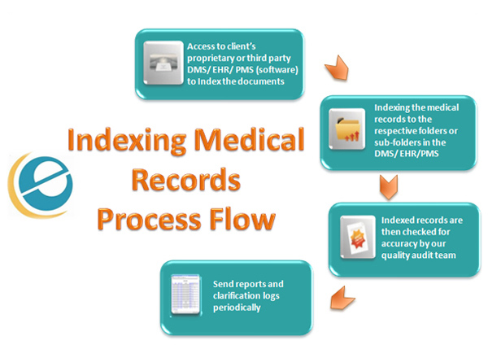
How to Index Medical Records?
Indexing is regarded as the process of describing and identifying documents in terms of their subject contents. Here, The concepts are extracted from documents by the process of analysis, and then transcribed into the elements of the indexing systems,
With technological improvement, Medical records are now electronically stored which necessitates indexing them to locate and retrieve them later. Files are electronically saved on
Electronic Medical Records (EMR) – This saves Medical reports from an individual practice or hospital
Electronic Health Records (EHR) – Can be accessed anywhere and help transmit medical records as required.

Slide 6
Outsourcing Indexing Medical Records
It is proven to be effortless, efficient and cost-effective comparatively as having in-house staff to handle such complex and laborious processes can mostly lead to additional costs and ineptitude processes causing stress during patient care and affecting Medical Billing Quality.
Benefits of Outsourcing Medical Record Indexing Process
Skilled workforce producing quality results at a competitive price
Quick and timely Process resulting in great patient care and Quality Medical Billing
Instantly retrievable data Indexed as per the clients’ requisition
Efficient Indexing of Medical Records leads to Quality and Timely Patient Care
Safe and secure Data Management to ensure PHI is accessible only to authorized users
Easy location of specific data or reports by Healthcare Practitioners and Physicians

Slide 7

FILING IN MEDICAL RECORD

Slide 8
Medical Records Numbering System
Three types of numbering systems are currently in use in health care facilities-serial, unit, and serial unit.
Serial numbering
In serial numbering the patient receives a new medical record number each time he is registered or treated by the hospital. If he is registered five times, he acquires five different medical record numbers.
Eg : Patient, Ravi, gets registered in the hospital and receives a number of 13650.When he returns for follow-up one month after treatment, he is registered under medical record number 14020. If he is visiting the hospital again the following year, he would receive still a third number such as 19560. Although all medical record numbers assigned to this patient has been recorded in the system, his medical records are filed in as many places as the number of times he has been treated in the facility.

Slide 9

Unit numbering
Similar to the serial numbering system, the unit numbering system provides a single record, which is composite of all data gathered on a given patient, whether as an outpatient, inpatient or emergency patient.
The patient is assigned a medical record on his first visit, which is used for all subsequent visits and treatments. His entire medical treatment is thus available in one folder under one medical record number.
For example: With unit numbering, each time Ravi arrived at the hospital for treatment, he would receive the first number he had been assigned –13650.

Slide 10

Serial unit numbering
This numbering system is a combination of the serial and unit numbering systems.
Although each time the patient is registered he receives a new medical record number, his previous record are continually brought forward and filed under the latest issued number.
For example: When patient Ravi returned for his follow-up one month after treatment, he would receive number 14020, but his out patient treatment data, filed under 13650, would also be brought forward to be filed with the old medical record made during his most recent visit. A unit record is thus created.
When the older records are brought forward, tracer card must be left in the shelf where the old record has been pulled, to indicate the new number under which the record is now filed. The tracer card marked with a referral note to the new number is a satisfactory method for accomplishing this.

Slide 11

Annual numbering
In annual numbering system, two digits indicating the year are added to the end of a serial number. The year designation serves as a control number in inactivating medical records. The serial numbers together with the calendar year also provide immediate data on the number of hospital registration or visits that occurred during a specific year.
Family numbering
Another version of unit numbering is the family numbering system. Family numbering usually consists of placing extra two digits, which indicates assigning number to each individual in the family.
These digits are usually placed instantaneously before the regularly assigned medical record number. Prefix number pairs have a definite order and meaning, as follows:
01 = Head of Family (either mother or father)
02 = spouse
03 = children
04 = any other family relatives

Slide 12

Medical Records Filing Systems
Three types of numeric filing systems are commonly used for filing medical records- straight numeric, terminal digit, and middle digit.
Straight numeric filing refers to the filing of records in exact ascending order according to medical records number. Thus, simultaneously all the numbered records would be in an ascending series on the filing shelves.
For e.g., the following four medical records would be filed in the following order on a shelf: 65023, 65024, 65025, and 65026.
The greatest advantage of this type of filing system is the ease with which personnel are trained to work with it.
This approach to filing has certain disadvantages. It is easy to misfile since a staff must consider all digits of the record number at one time when filing a record. The greater the number of digits that must be recalled when filing, the greater the chance for error. Alteration of numbers is common: medical record 65424 can be misfiled as record 56524.
A more serious problem to straight numerical filing is that the heaviest filing activity is concentrated in the area with the maximum number of new records. Several staff filing records at the same time in such areas is bound to get in each other’s way. Since staffs are usually filing in the area of the most current records, it is not possible to fix responsibility for a section of the file to one staff.
Straight numeric filing

Slide 13
Terminal digit filing
A six-digit number or a seven-digit number can be used and divided with a hyphen into three parts, each part normally containing two digits. Within the number, the primary digits are the last two, secondary digits are the middle two and, the tertiary digits are the first two or three digits.
In a terminal digit filing, there are 100 primary sections, ranging from 00 to 99. A staff must first consider the primary section while filing the records. With each primary section, groups of records are matched according to the secondary digit, after locating the correct secondary digits section, the medical record staff files in numerical order by the tertiary digits. In medical records, the second tertiary digits changes with every Record.
66-31-06 | 98-11-38 | 98-99-50
67-31-06 | 99-11-38 | 99-99-50
68-31-06 | 00-12-38 | 00-00-51
69-31-06 | 01-12-38 | 01-00-51
Note the following example in a terminal digit file
The terminal digit method of filing is described using six numbers, but as mentioned earlier it can be adapted for using five, seven, or even nine digits. With a five-digit number, one could break it into three sections, as follows:
7-65-43 | 0-00-01 | etc.
With seven digits, the break up might be:
765-43-21 | 000-00-01 | etc.

Slide 14

Advantages of terminal digit filing
Misfiling is considerably reduced with the use of terminal digit filing. Since the staff is concerned with only one pair of digits at a time, the transposition of numbers is less likely to occur.
Even if the tertiary digits are increased to three, e.g., 245-68-90, recalling three digits is easier than recalling seven.
The training period for medical records assistant is usually a little longer for a terminal digit system than for a straight numeric filing, but most of the staff can learn it in a few days time.
Initial setting up of file shelves may be required from the starting stage, which may require more units of shelving since expansion capabilities must be planned for the total medical records area.

Slide 15
Middle digit filing
In this method the staff files according to pairs of digits, as in terminal digit filing. On the other hand, the primary, secondary, and tertiary digits are in different positions. The middle pairs of digits in a six-digit number are the primary digits, the digits on the left are the secondary digits, and the digits on the right are the tertiary digits
76 | -- | 68 | -- | 96
Secondary |  | primary |  | tertiary
Shown below is a sample sequence in middle digit file
76-68-96 |  | 99-68-96
76-68-97 |  | 99-68-97
76-68-98 |  | 99-68-98
From the example given, the staff can see that blocks of 100 records (e.g., 76-78-00 through 76-78-99) are in straight numerical order.

Slide 16


This has several advantages:
First, it is simple to pull out 100 consecutively numbered records for research purposes.
Second, conversion from a straight numerical system to a middle digit system is much simpler than converting to a terminal digit system.
Third, blocks of 100 records pulled from a straight numerical file are in exact order for middle digit filing.
Middle digit filing provides a more even distribution of records that does straight numerical filing, although it does not equal the balance achieved by a terminal digit filing system.
As in terminal digit filing, the staff is filing by pairs of digits rather than by six or seven digits; therefore wrong filing is reduced.
There are certain disadvantages to middle digit filing. More training may be necessary than the straight numeric or terminal digit filing.

Slide 17
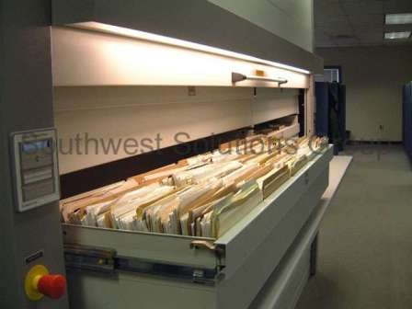
THANK YOU

